Slide 1

PROBLEM STATEMENT Developing a cutting-edge telehealth solution that revolutionizes healthcare-service delivery, prioritizes patient-doctor communication, remote monitoring, and real-time data analysis. The goal is to enhance the overall efficiency, improve outcomes, and advance telemedicine. The solution should be scalable, user-friendly, and compatible with existing healthcare systems.

Slide 2
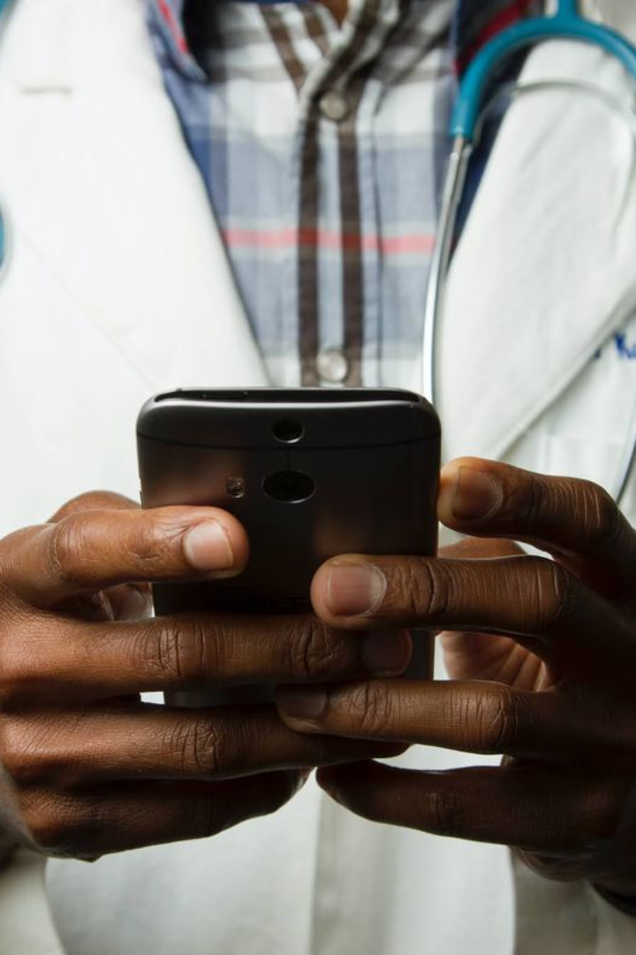
Medi-Link
"Pioneering Telehealth Excellence for Enhanced Patient Care"
BY TEAM TECH TATES
P N SANJAY
RUPIN AJAY
CH SRICHERAN
P V S SUKRITH

Slide 3
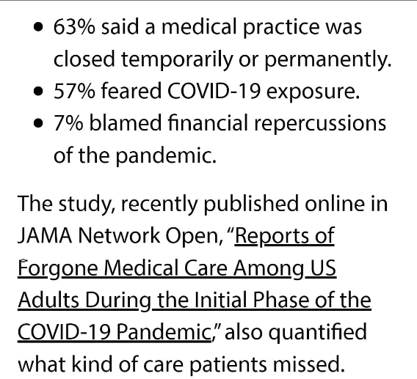
Required Need Of the Hour
India’s Covid crisis exposes deep-rooted problems in public health after years of neglect.
reference(https://www.cnbc.com/2021/05/18/india-covid-crisis-shows-public-health-neglect-problems-underinvestment.html)
One in five in U.S. report delayed health care during pandemic.
reference(https://www.hsph.harvard.edu/news/hsph-in-the-news/one-in-five-in-u-s-report-delayed-health-care-during-pandemic/)

Slide 4
STEPS OF PROGRESS FOR MEDILINK
Step 1: Skin Care Disease Detection :
Integrate a model for skin disease detection from user-uploaded images, offering medication recommendations and telemedicine integration(e.g-mails )
Step 2: Disease Detection Model with text or uploading existing reports for insights:
Develop machine learning models for user symptom input, providing initial diagnoses or recommendations.
Step 3: Health Data Analysis:
Analyze changing heart health metrics from datasets, identifying patterns or anomalies for monitoring.
Step 4:Virtual Platforms for real time heart rate monitoring and insights.
Enable heart rate data monitoring made vital for analyzing the data received from it and provide insights.

Slide 5
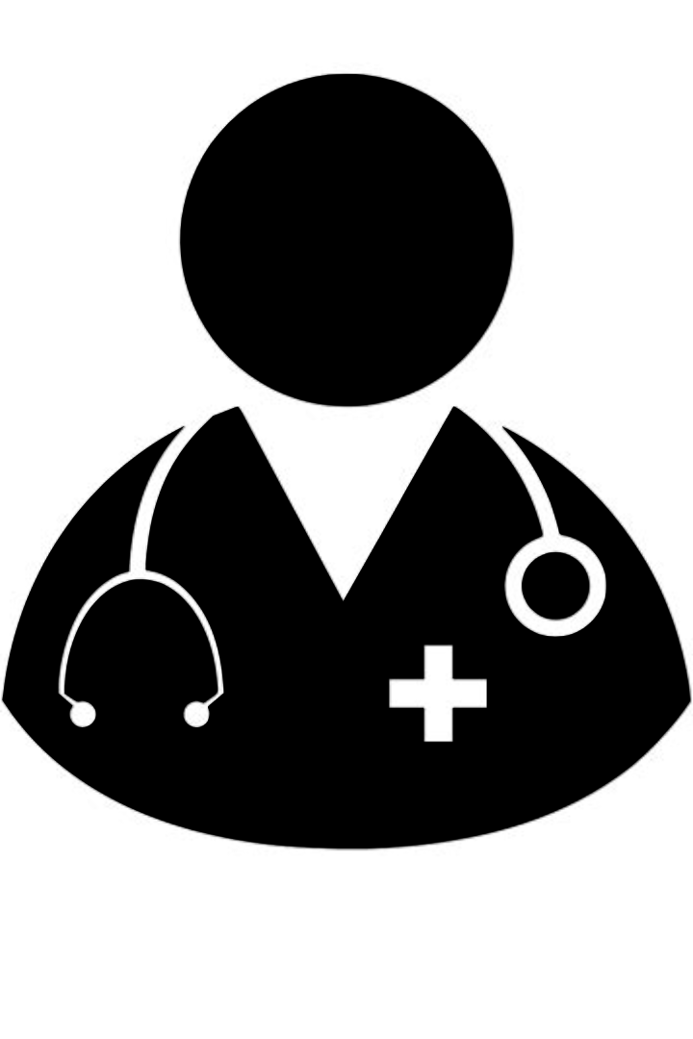
INTRODUCTION
Introducing Medi-Link
Medi-Link is a cutting-edge health management platform revolutionizing healthcare delivery through personal recommendations, telemedicine consultations, and seamless integration of user-provided health data, empowering individuals to take control of their well-being with ease and convenience.

Slide 6
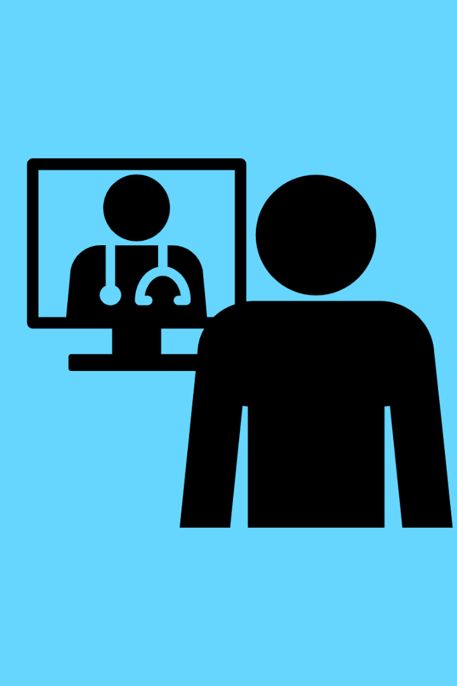
Prototype for our Telemedicine Integration System
MediLink is a cutting-edge telehealth platform facilitating remote consultations and personalized care. Users can upload health data, schedule telemedicine appointments, and receive automated recommendations.
The platform ensures seamless connectivity between patients and healthcare experts, fostering and efficient communication. By streamlining healthcare delivery, MediLink empowers users to take control of their well-being and receive quality medical assistance remotely.

Slide 7
Technological Stack
Tech Stack:
Python: Core programming language.
Streamlit: Framework for creating interactive web applications.
pytesseract: Performs Optical Character Recognition (OCR) for text extraction from medical report images.
langchain_community.llms.Ollama: Custom NLP model for medical text analysis.
Components:
Frontend/UI: Streamlit with HTML/CSS for styling.
Backend/Processing: Python libraries for image processing, OCR, and NLP with CNN's.
Data Processing: pytesseract extracts text, Ollama analyzes medical text.

Slide 8
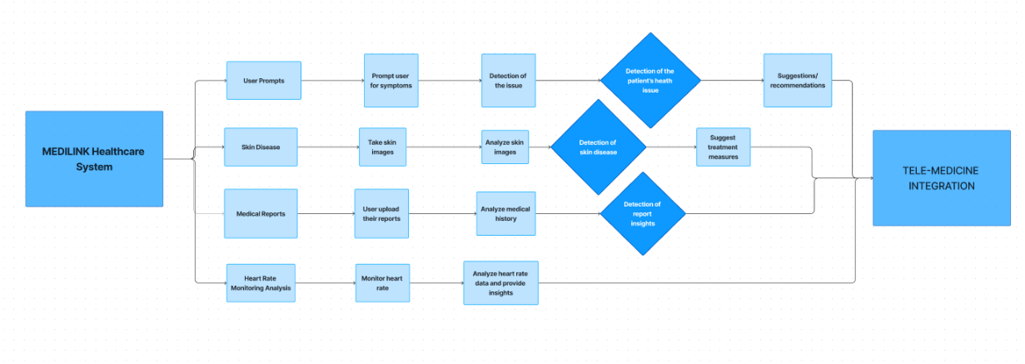
WORKFLOW

Slide 9
USECASES /ADVANCEMENTS
Dermatology Implementation: Enable accurate predictions of skin diseases through image uploads, offering detailed diagnoses and personalized recommendations for proactive management and automated communication between doctors and patients via emails.
Areas of implementation: Chemical Factories, Construction Sites, Healthcare Facilities, and Dermatology Clinics .
2. Medical Report Analysis: MediLink conducts thorough medical report examinations, offering actionable insights and tailored recommendations for proactive healthcare management.
Areas of Implementation: Hospitals, clinics, diagnostic centers, healthcare facilities.
3. Remote Consultations: Enable patients to interact with our model for detailed health issue responses, fostering accessibility to medical advice and reducing in-person visits totally.
Areas of Implementation: Rural communities, remote villages, underserved urban areas.
4.Real time heart rate data monitoring: Enable heart rate data monitoring made vital for analyzing the data received from it and provide insights.
Areas of Implementation: Remote heart rate monitoring for elderly care, future uses for fitness and performance tracking.

Slide 10
WHY MEDILINK?
Accessibility: We prioritize accessibility, ensuring that healthcare services are readily available to all users, regardless of any other factors. With MediLink, patients in and around also remote areas can easily access our model and connect with healthcare providers for medical advices
Scalability/Customized Solutions for Every Need: Whether you require skincare analysis, personalized health prompts, detailed medical report insights, or heart rate monitoring, MediLink offers customized solutions to meet your specific requirements. Our adaptable platform caters to diverse healthcare needs, ensuring that users receive tailored services for optimal care.
Seamless Integration: It effortlessly integrates communication between patient and health experts maximizing the outputs with AI tools as a boost or can be used as a second opinion
User-Friendly Interface: MediLink offers an intuitive and user-friendly interface, making it easy for patients to navigate the platform. Our streamlined design enhances user experience and promotes efficient interaction with AI- models facilitating smoother healthcare delivery via telemedicine integration.

